Slide 1
Literary Elements

Slide 2
Simile
A comparison using like or as
Example: Life is like a box of chocolates. You never know what you’ll get inside.

Slide 3
Metaphor
A comparison NOT using like or as.
Example: Life is a roller coaster.

Slide 4
Personification
A thing, an idea, or an animal is given human attributes.
Example: The avalanche devoured anything standing in its way.

Slide 5
Alliteration
Repetition of consonant sounds.
Example: Peter Piper picked a peck of pickled peppers.

Slide 6
Sensory details
Details that include sight, sound, touch, smell, and taste.
Example: The walls shook and vibrated like the tail of a rattle snake.

Slide 7
repetition
Repeating a specific word or phrase for emphasis.
Example:
And miles to go before I sleep, and miles to go before I sleep.
-Robert Frost “Stopping by Woods on a Snowy Evening”

Slide 8
Allusion
A reference (historical, art, biblical, etc), the author expects you to know.
Example:
When she lost her job, she acted like Ebeneezer Scrooge.

Slide 9
Soliloquy
When one person is on stage by themselves giving a speech to the audience. This speech shows a character’s inner thoughts.

Slide 10
Monologue
When one person on stage gives a speech for an extended amount of time. Other characters are around. The character may not be telling us the truth, but what the other characters want to hear.

Slide 11
Tragedy
Kind of drama that presents a serious subject matter about human suffering and corresponding terrible events in a dignified manner.

Slide 12
Tragic Hero
A literary character who makes a judgment error that inevitably leads to his or her own destruction.

Slide 13
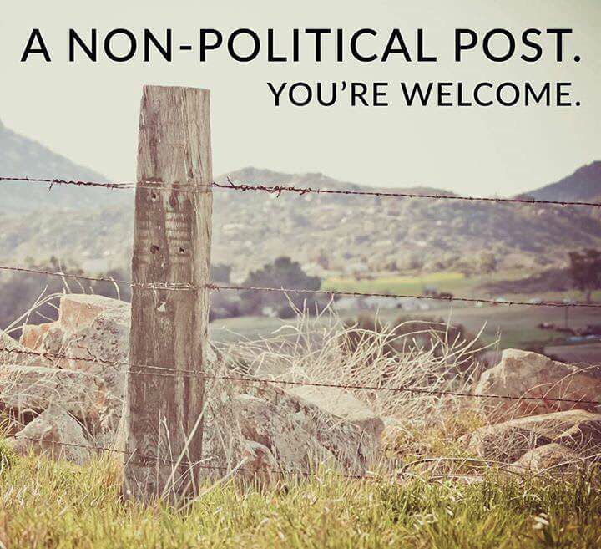
Pun
A play on words

Slide 14
Parallel Structure
The repetition of grammatical structure
Example: To err is human; to forgive is divine.

